Slide 1








The DIET WebBoard

Slide 2
DIET WebBoard
The Decrypthon grid
Functionalities of the DIET WebBoard
Using the DIET WebBoard with a new application.

Slide 3
The Decrypthon Grid

Slide 4



The Decrypthon Grid
The Decrypthon project is resulting from the collaboration between the CNRS, the AFM and IBM.
The aim is to provide computing ressources and storage spaces to the researchers in bioinformatics.
The means are an university grid, and an internet users grid.

Slide 5
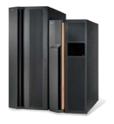
The Decrypthon University Grid
Orsay site :
Linux web server (2)
AIX University cluster (Loadleveler)
ENS Lyon site :
AIX server for IBM WII and data Manager
Linux ”GDSDMI” University cluster (OAR)
Lille site :
AIX University cluster (Loadleveler)
Renater
Network
Bordeaux site :
AIX University cluster (Loadleveler)
Jussieu site :
AIX University cluster
CRIHAN (Rouen) :
Database server

Slide 6


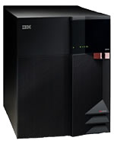


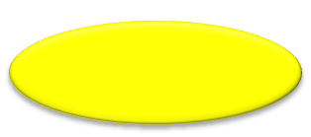

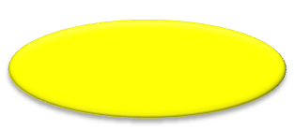

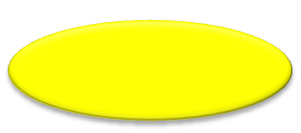
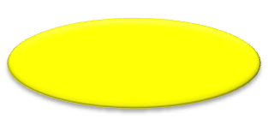
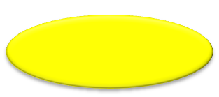

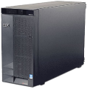



DIET on the decrypthon grid
Web portal
MA
Project Users
client
Orsay
Decrypthon1
Orsay
Decrypthon2
SeD
SeD
SeD
SeD
SeD
IBM WII
CRIHAN
DB2
Data manager interface
Clinical
AFM DB

Slide 7
Functionalities of the DIET WebBoard

Slide 8
Functionalities of the DIET WebBoard
Using GoDIET to deploy a DIET Hierarchy
Identification of the users and their permissions
Add the concept of ”Jobs” and ”Workunits” as an abstraction of the DIET ”request” system.
Displaying statistics about the grid usage
Constitutes an API for end user interfaces

Slide 9
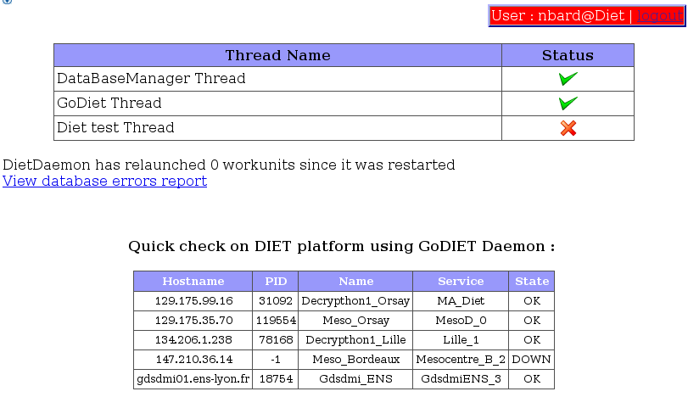
GoDIET
This page shows the main threads of the DIET WebBoard :
DataBase Manager Thread
GoDIET Thread
Test thread
You can also see that this page reports the output of a ”check” request to GoDIET.

Slide 10
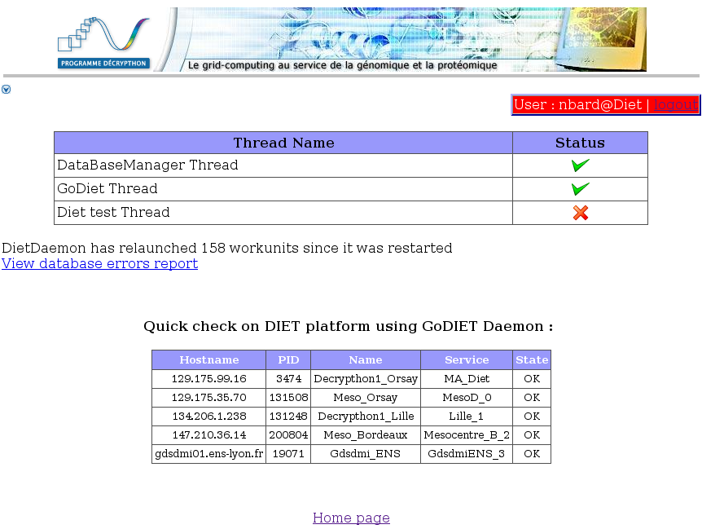
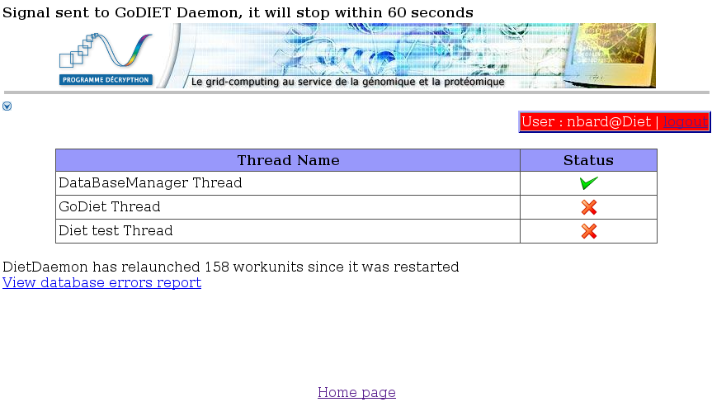
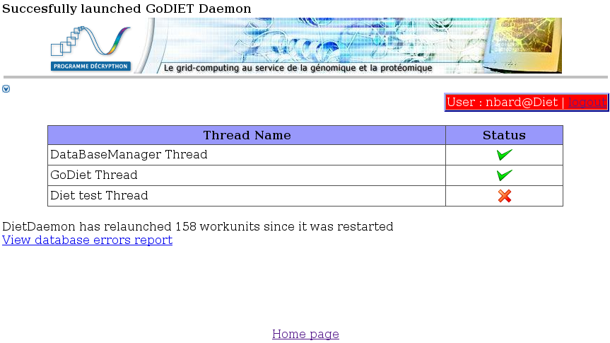
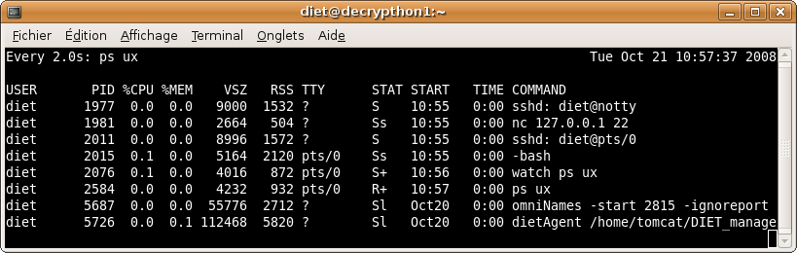
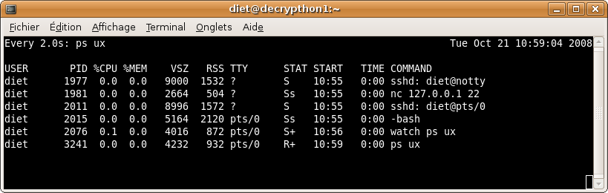
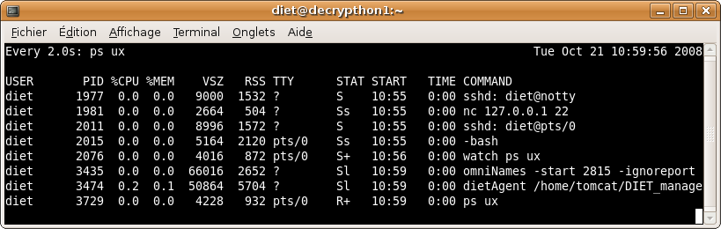
GoDIET Thread

Slide 11
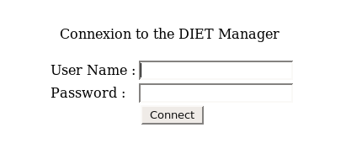
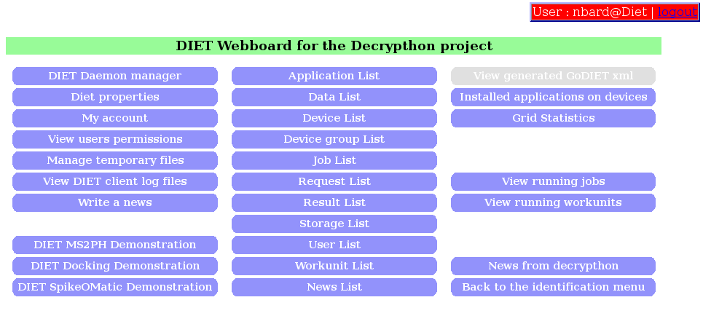
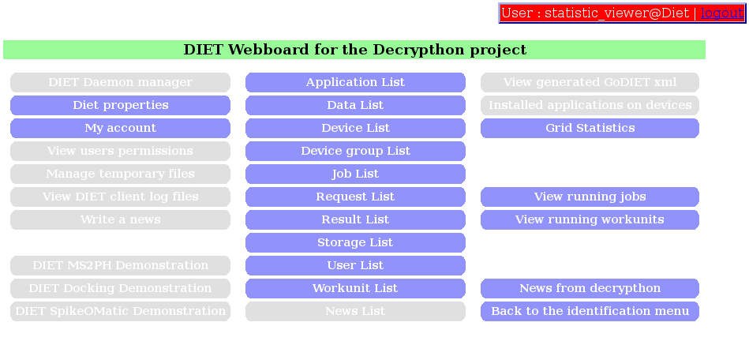
Identification
Users must log in the interfaces using a password.
The main page can be different according to the permissions granted to the user connecting on the DIET WebBoard.
On this example the user ”nbard” (first picture) has a full access when the user ”statistic_viewer” (second picture) can only access statistics pages.

Slide 12
Jobs and Workunits
Workunit
Data + Parameters
Result
Project Users
Workunit
Result
File
Parameters
Workunit
Result
Application
User
Interface
Workunit
Result
DIET
WebBoard
Workunit
Result
Workunit
Result
Workunit
Result
Result
Compilation
Archive
Workunit
Result
Workunit
Result
Job

Slide 13
The story of a Workunit
Decrypthon server
Files
Application
Interface
MySQL
DIET
WebBoard
DIET
Client
Project Users
Parameters
Storage
Data
Master
Agent
SeD
Result
SeD
Batch scheduler
SeD

Slide 14
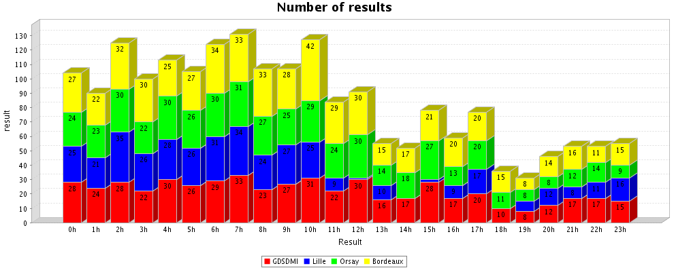
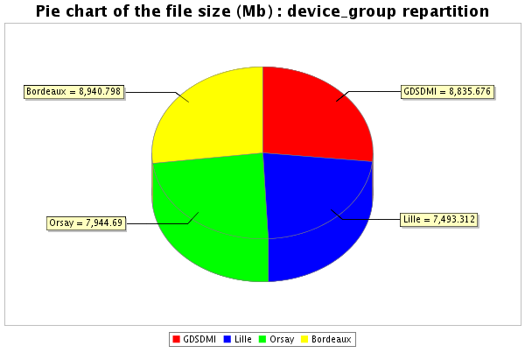
Grid Statistics
Number of results per hour the 12/09/2008
Pie chart : Memory usage of the results
produced during the month of September 2008

Slide 15
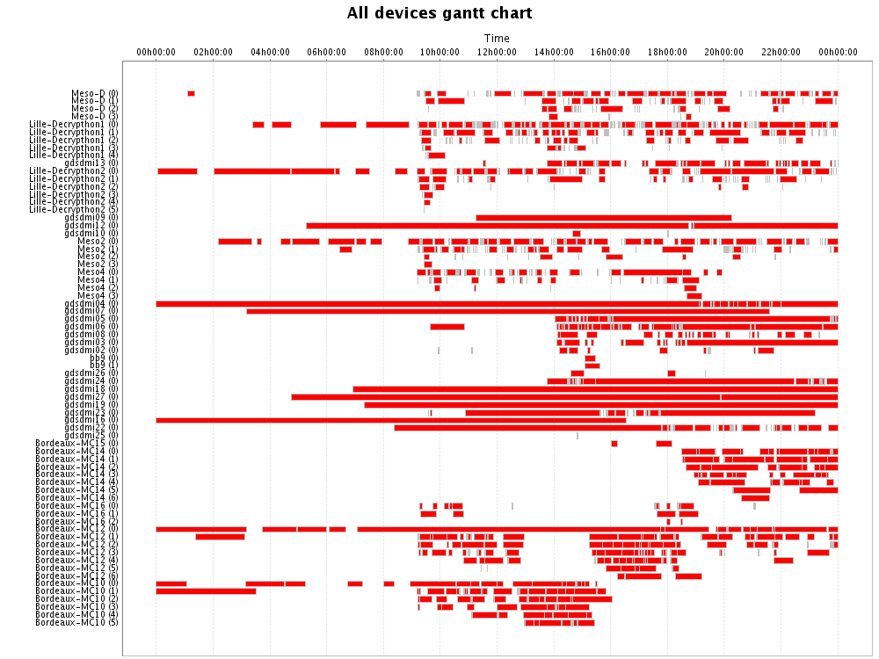
Grid Statistics

Slide 16
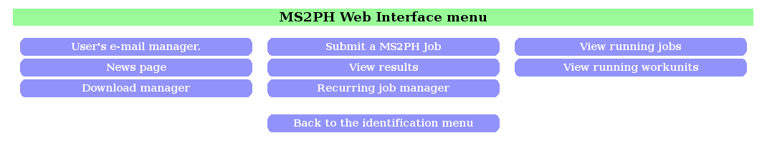
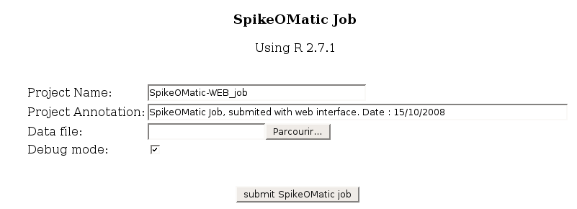
Users Interfaces
This interface is designed for end users.
To make an user interface for a new application on the grid you only need to write the page for submitting jobs : using DIET WebBoard Core libraries.

Slide 17
Using the DIET WebBoard
with a new Application

Slide 18
Using DIET WebBoard with a new Application
Tomcat server
MySQL server
MySQL
Application Interface
DIET WebBoard
Application Interface
Application Interface

Slide 19
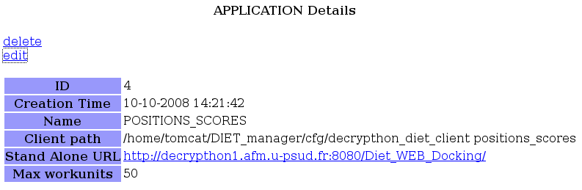
Using DIET WebBoard with a new Application
A DIET platform and a DIET Client
client
The client will be used by the DIET WebBoard to submit jobs to the grid.

Slide 20
Using DIET WebBoard with a new Application
Sequences list
Fitting your application to the DIET WebBoard's
Jobs, Workunits and Results system.
TCL script
Blast
Ballast
Wu
Script
R
Filter
Wu
Script
R
Clustalw
Wu
Script
R
Rascal
NormD
Results
Sequences list
Wu
Script
R
Leon
Wu
Script
R
NormD
Wu
Script
R
Clustering
Wu
Script
R
Macsim
Wu
Script
R
Results

